Slide 1
Microsoft Fabric
Introducing the new Microsoft Fabric solution
Notes:
Introduce the Microsoft team to the customer

Slide 2

Today’s data value creation challenges
Breaking down data siloes across the organization into a unified source of truth
Balancing the need for data access and self-service analytics while remaining governed
Delivering on the promise of analytics with limited resources
Limited scalability of legacy solutions as data demand rises exponentially
Notes:
We’ve talked to a wide range of customers who have led their organization in data-first modernization. And we understand that businesses today face a variety of data and analytics challenges that can be difficult to navigate.
These challenges require thoughtful planning and strategic decision-making to ensure that businesses can use data effectively to stay ahead of the competition.
To put this into perspective, research shows “the amount of data created over the next three years will be more than the data created over the past 30 years.” Investing in the technology you need to make real-time, data-driven decisions without compromising security or governance is critical for your organization’s long-term success.
Source: IDC Global DataSphere Forecast, 2020

Slide 3
Title slide 4
“
I am the Chief Data Officer and don’t want to be the Chief Integration Officer.
Every CDO, Every Enterprise
3
Microsoft Fabric
Notes:
We’ve talked to a wide range of customers who have led their organization in data-first modernization. And we understand that businesses today face a variety of data and analytics challenges that can be difficult to navigate.
These challenges require thoughtful planning and strategic decision-making to ensure that businesses can use data effectively to stay ahead of the competition.
To put this into perspective, research shows “the amount of data created over the next three years will be more than the data created over the past 30 years.” Investing in the technology you need to make real-time, data-driven decisions without compromising security or governance is critical for your organization’s long-term success.
Source: IDC Global DataSphere Forecast, 2020

Slide 4
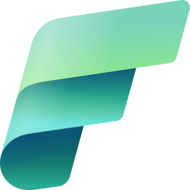



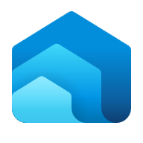
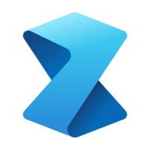

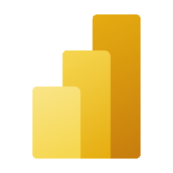
Introducing Microsoft Fabric––a unified analytics solution for the era of AI
Single…
Onboarding and trials
Sign-on
Navigation model
UX model
Workspace organization
Collaboration experience
Data Lake
Storage format
Data copy for all engines
Security model
CI/CD
Monitoring hub
Data Hub
Governance & compliance
OneLake
Data Factory
Synapse
Data Engineering
Synapse
Data Warehouse
Synapse
Data Science
Synapse
Real-Time Analytics
Power BI
Lake-centric and open
Role-specific tools
Empower every Microsoft 365 user
Persistent governance and security
Notes:
Introducing Microsoft Fabric, a unified analytics solution for the era of AI.
Unified Analytics
Lake-centric and open
Empower individuals, teams and organization to do more
Pervasive security and governance
From a Data Integration standpoint: Microsoft Fabric offers comprehensive data migration and integration to enable a lake-first pattern. Azure Data Factory connectors enable data integration, while Azure Synapse Link connectors enable “no code” and “always synchronized” data integration for operational databases.
From a data organization perspective, Microsoft Fabric leverages OneLake: This ensures that all data is ingested into a data lake on Azure Data Storage Gen––a cost- and performance-optimized storage service––for the most demanding business intelligence, machine learning, and artificial intelligence workloads.
On an Analytics front: Data scientists can bring their preferred compute frameworks, languages, runtimes, and tools to the data lakehouse and further enhance the data through feature engineering and statistical techniques.
When it comes to Business Intelligence: The Microsoft Intelligent Data Platform (MIDP) offers best-in-class integrated solutions to responsibly democratize business intelligence with self-serve tools and experiences for data analysts and data citizens.
And lastly, from a Governance standpoint: Microsoft Purview then provides a single pane governance solution to help effectively scan and manage your data estate––even as it grows and scales.

Slide 5
Experiences overview

Slide 6
Six key experiences for end-to-end analytics
Experiences are designed to target specific personas and tasks, yet work together seamlessly in a unified platform via OneLake to enable creators to collaboratively do their best work
Combines the ease of use of Power Query with the scale and Power of Azure Data Factory to leverage 200+ native connectors to data sources on premises and in cloud
World-class Spark platform with great authoring experiences to empower data engineers to transform data at scale
Providing industry leading SQL performance and scale, fully separating compute from storage for independently scaling and natively storing data in open Delta Lake
Build, deploy, and operationalize machine learning models directly within Fabric to empower data scientists and analysts with predictive insights
Best-in-class engine for observational data analytics to create actionable insights from real-time data
The world’s leading business intelligence platform empowers users to quickly and intuitively to make better decisions with data
Notes:
Microsoft Fabric is a unified SaaS based solution comprised of six key experiences, designed to target specific personas and tasks, while working seamlessly together on a unified lake-first foundation. Together, these six experiences help organizations unlock the transformative value of data. Let us look at each of these key experiences in detail.

Slide 7


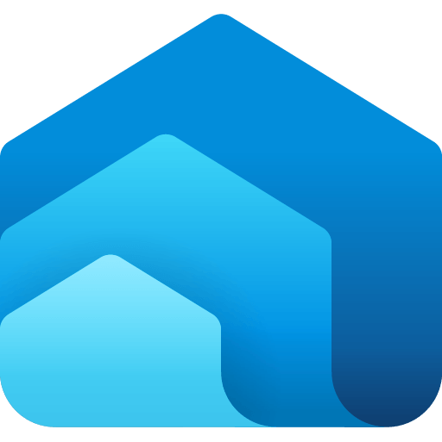
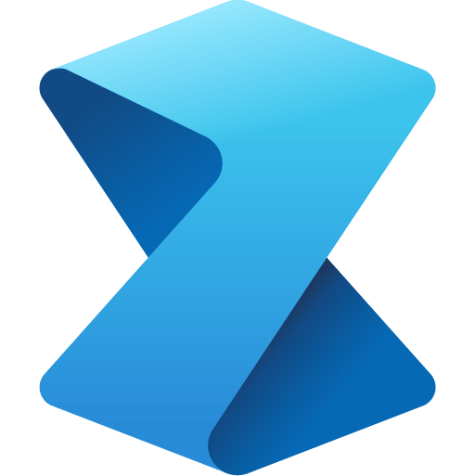




Data integration experience
Bring together low-code, AI-enabled experiences, multi-cloud connectivity, and persistent data security and governance to help solve complex scenarios for all developers
200+ native data source connectors
Data Integration
Data Engineering
Data Warehouse
Data Science
Real Time Analytics
Business Intelligence
Cloud-scale data movement with Data Factory
Data Factory
Synapse
Synapse
Synapse
Synapse
Power BI
Low-code interface for ingesting data from hundreds of data sources using Dataflows Gen2
Serverless Compute
Petabyte scale transformation
OneLake
Powerful, enterprise-grade Data Factory experience with the best of ADF and Power Query together
Security, Governance and Administration
Notes:
Data integration brings the best of Azure Data Factory and Power Query together in one experience. This brings low-code, AI-enabled data preparation and transformation experiences, petabyte-scale transformation, and hundreds of connectors with hybrid, multi-cloud connectivity––all governed via Purview with enterprise promises of Data/Op/CI/CD, Application Lifecycle management, and monitoring

Slide 8

Data engineering experience
Build you data estate and empower data engineers with a world-class Spark platform, fully integrated with Data Factory, to transform and democratize data at scale
World-class Spark serverless compute
Pro and low-code authoring experience
Schedule and orchestrate data transformations with notebooks and Spark jobs
Launch clusters on demand and dynamically scale in, scale out, pause, and resume
Perform code-free interactive data exploration and add to your data pipeline
Data Integration
Data Engineering
Data Warehouse
Data Science
Real Time Analytics
Business Intelligence
Data Factory
Synapse
Synapse
Synapse
Synapse
Power BI
Serverless Compute
OneLake
Security, Governance and Administration
Notes:
Data Engineering empowers data engineers to transform data at scale and democratize data with a low-code Lakehouse experience. A world-class Synapse Spark serverless compute, pro and low-code authoring experiences, and the ability to dynamically scale and orchestrate data are key elements.

Slide 9
Data warehouse experience
Achieve data platform goals with east and cost efficiency, while empowering your developers and engineers with accelerated reporting and insights
Industry-leading SQL performance and scale, including reporting tools using T-SQL and TDS end-points
Fully separate compute storage that can independently scale
Build relational layers on top of physical data in lakehouse and natively store data in open Parquet/Delta Lake to remove need for data duplicity
Consumer data with Power BI for reporting and visualization
TLS 1.2 encryption protects all connections for granular security across your data platform
Data Integration
Data Engineering
Data Warehouse
Data Science
Real Time Analytics
Business Intelligence
Data Factory
Synapse
Synapse
Synapse
Synapse
Power BI
Serverless Compute
OneLake
Security, Governance and Administration
Notes:
Data Warehouse allows your to achieve data platform goals with ease and cost efficiency. The Enterprise grade Data Warehouse builds relational layers on top of the physical data in the Lakehouse, providing a fully separate compute from storage that can independently scale backed by industry leading SQL performance.

Slide 10
Data science experience
Build, deploy, and operationalize machine learning models with boundaryless collaboration and seamless integration with Azure ML
Access data from multiple sources and store data and insights in lakehouse(s)
Leverage data science capabilities for model prediction at scale to gain and share business insights
Iterate, build, and track Machine Learning experiments using ML flow
Perform transformation, exploration, and featurization by leveraging built-in experiences
Collaborate with others via Notebook, Power BI, and lakehouses in real-time
Data Integration
Data Engineering
Data Warehouse
Data Science
Real Time Analytics
Business Intelligence
Data Factory
Synapse
Synapse
Synapse
Synapse
Power BI
Serverless Compute
OneLake
Security, Governance and Administration
Notes:
Data science allows users to build, deploy, and operationalize machine learning models leveraging data from diverse sources and supporting secure collaboration. Easily integrate with Azure Synapse ML for experiment tracking and model registry, processing of millions of prompts, and the ability scale workflows easily. We'll look into more specific capabilities later on in today's presentation.

Slide 11
Real-time analytics experience
Unlock value and turn insights into actions with real-time analysis across telemetry data to better predict, optimize, and improve data applications
High velocity, low latency data analysis capable of indexing diverse data formats and structures up to several petabytes large
Leverage Kusto Query Language (KQL) to explore data and discover patterns, identify anomalies and outliers, and create statistical modeling
Easy ingestion of data from any source, in any data format, like applications, websites, and IoT devices
Democratize data responsibly with Microsoft Purview and use observability with Data Activator to activate timely actions
Data Integration
Data Engineering
Data Warehouse
Data Science
Real Time Analytics
Business Intelligence
Data Factory
Synapse
Synapse
Synapse
Synapse
Power BI
Serverless Compute
OneLake
Security, Governance and Administration
Notes:
With a best-in-class observational data analytics engine, real-time analytics allows organizations to unlock value by analyzing time series, telemetry, or log type datasets. The ability to support semi-structured data at high volume, coupled with capacity for unlimited scale from gigabytes to petabytes, enables unlimited scale at concurrent queries and concurrent users.

Slide 12
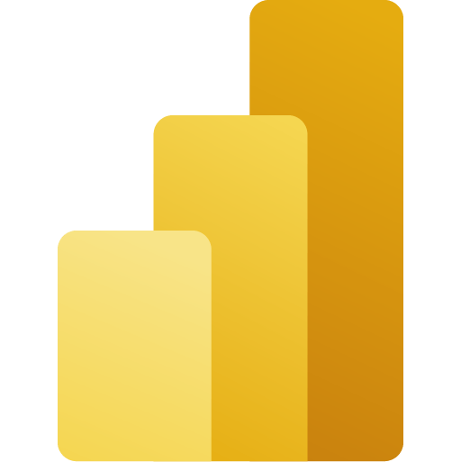
Business intelligence experience
Uncover powerful insights with intelligence visuals, leverage data quickly and intuitively, and help achieve faster and better data-based decisions with the industry leading Power BI platform
Native Integration with Microsoft 365
Powerful built-in AI capabilities and visuals illuminate hidden patterns, opportunities and anomalies in data with the click of a button
Connect to, index, and certify datasets in the Power BI data hub
Build governed databases, like data models or data marts, in a trusted and secure hub
Data Integration
Data Engineering
Data Warehouse
Data Science
Real Time Analytics
Business Intelligence
Data Factory
Synapse
Synapse
Synapse
Synapse
Power BI
Serverless Compute
OneLake
Security, Governance and Administration
Notes:
Power BI is the world's leading Business Intelligence platform. Fully integrated into Microsoft Fabric, it ensures data can be leveraged by users quickly and intuitively, helping achieve faster and better data-based decisions.

Slide 13
Serverless compute
Run workloads without having to provision compute. Live compute pools are already provisioned with a workspace resulting in instant productivity.
Limitless scale for the most demanding jobs
Automatically create with each workspace With support for high concurrency mode there’s no need to start a new session to run a notebook Memory optimized
Data Integration
Data Engineering
Data Warehouse
Data Science
Real Time Analytics
Business Intelligence
Data Factory
Synapse
Synapse
Synapse
Synapse
Power BI
Serverless Compute
OneLake
Security, Governance and Administration
Notes:
Serverless compute is a compute tier for single databases in Azure SQL that automatically scales compute based on workload demand. It allows for workloads to run without the need to provision compute, enhancing productivity, optimizing memory, and creating a highly scalable environment.

Slide 14
Unified data foundation with OneLake
Eliminate pervasive and chaotic data siloes to provide a unified, secure, and centralized storage system for developers with OneLake––the “OneDrive” for data
A single SaaS lake for the whole organization
Abstraction layer over Azure Storage and third-party storage services, provisioned automatically with the tenant
All workloads automatically store their data in OneLake workspace folders
All data is organized in an intuitive hierarchical namespace
Data in OneLake is automatically indexed for discovery, sharing, governance, and compliance
Data Integration
Data Engineering
Data Warehouse
Data Science
Real Time Analytics
Business Intelligence
Data Factory
Synapse
Synapse
Synapse
Synapse
Power BI
Serverless Compute
OneLake
Security, Governance and Administration
Notes:
As we mentioned earlier, these workload experiences are built on a unified data foundation via OneLake. This open and governed lake-centric hub eliminates data siloes and securely centralized data for the whole organization. It acts like the data version of Microsoft OneDrive. We’ll look into this incredible foundation more closely in a moment.

Slide 15

Persistent data governance and security
Built-in security and reliability features secure your data, and a set of governance and compliance capabilities help you manage, protect, and monitor sensitive information
Centralized Administration via the Admin Center
Governance powered natively by Microsoft Purview Insights via Admin Monitoring, Capacity Insights and more, enabling effective administration and governance Security at Data, Workspace and Network layers Key enterprise promises like data residency, auditability and much more
Data Integration
Data Engineering
Data Warehouse
Data Science
Real Time Analytics
Business Intelligence
Business Intelligence
Data Factory
Synapse
Synapse
Synapse
Synapse
Power BI
Power BI
Serverless Compute
OneLake
Security, Governance and Administration
Notes:
Throughout Microsoft Fabric, there is persistent data governance and security to manage, protect, and monitor your data.
Security features:
Conditional access - Secure your apps using Azure Active Directory (Azure AD).
Resiliency - Reliability and regional resiliency with Azure availability zones.
Lockbox - Control how Microsoft engineers access your data.
Service tags - Enable an Azure SQL Managed Instance (MI) to allow incoming connections from Microsoft Fabric.
Governance and compliance:
https://learn.microsoft.com/en-us/fabric/governance/governance-compliance-overview
Information protection
Data loss prevention
Endorsements
Metadata scanning
Lineage
Microsoft Purview hub
What is Microsoft Fabric governance and compliance? - Microsoft Fabric | Microsoft Learn

Slide 16
OneLake overview
Notes:
Now that we’ve had an overview of these key elements of Microsoft Fabric, we will explore the specific technical capabilities in more detail. Let’s begin with the foundation for this unified and secure solution, with OneLake.

Slide 17
OneLake for all domains
A true data mesh across organization domains
Sales
Marketing
Finance
Introducing domains as an integral part of Fabric: A domain is a way to logically group together all the data in an organization relevant to an area or field, according to business needs
Data
warehousing
Data
engineering
Data integration
Data
science
Real-time
analytics
Business intelligence
Domains are defined with domain admins and contributors who can associate workspaces and group them together under a relevant domain
Federated governance can be achieved by delegating settings to domain admins, thus allowing them to achieve more granular control over their business area
Unified management and governance
OneLake
Domains simplify discovery and consumption of data across the organization, thus allowing business optimized consumption
Sales
Marketing
Finance
Workspace
POS sales
Certified
Workspace
online sales
Certified
Workspace
customer
Workspace
ads
Promoted
Workspace
expenses
Avoid data swamps by endorsing certain data as certified or promoted, thus encouraging reuse.
Notes:
Different business groups are now able to work independently within the same data lake without the overhead of managing different storage resources. They are already able to implement the popular data mesh pattern more efficiently than they could before. OneLake takes this even further with the introduction of domains as a first-class concept. A single business domain may have multiple workspaces as workspaces tend to align with specific projects or teams.
A domain is a way of logically grouping together all the data in and organization that is relevant to an area or field.
Domains are defined with domain admins and contributors who can logically group together workspaces under those domains..
Domains provide a management boundary between tenant and workspace enabling admins to have more granular control over multiple workspaces.
As you will see later, domains also simplify discovery and consumption of data across the entire organization. Now that we are making it so easy for different parts of the organization to work on the same data lake without going through a central gatekeeper, you might be thinking that you want to block certain users from adding to the lake. If anyone can add to the data lake, then these can quickly become data swamps with data from official sources mixed with data from unofficial sources. The problem with blocking users from OneLake, is that they will just create another data lake somewhere else. When they do that, you will have no idea if that data is properly governed or even how it is being used. If they add their data to OneLake, it will be automatically governed and still under the control of the admins who will start to get more and more insights on how that data is being used.
You can avoid data swamps in OneLake through data endorsements. Domain owners can officially certify data or recommend data so that the important data rises to the surface while the rest sinks to the bottom.

Slide 18
OneLake for all data
“The OneDrive for data data”
A single SaaS lake for the whole organization
Provisioned automatically with the tenant
All workloads automatically store their data in the OneLake workspace folders
All the data is organized in an intuitive hierarchical namespace
The data in OneLake is automatically indexed for discovery, MIP labels, lineage, PII scans, sharing, governance and compliance
Data Integration
Data Engineering
Data Warehouse
Data Science
Real Time Analytics
Business Intelligence
Serverless
Compute
Spark
T-SQL
KQL
Analysis Services
OneLake
Storage
Warehouse
Lakehouse
KQL DB
Semantic Dataset
Delta – Parquet Format
Delta – Parquet Format
Delta – Parquet Format
Delta – Parquet Format
Notes:
Colin to add notes

Slide 19
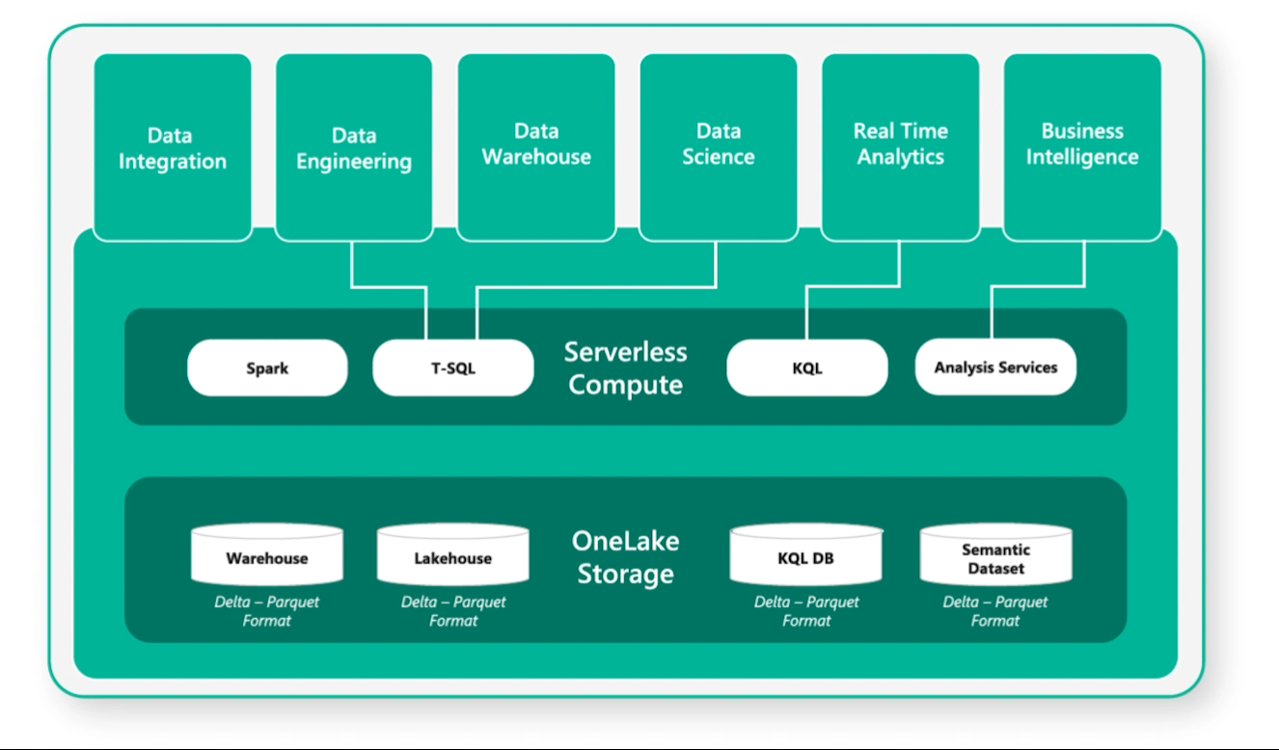
One copy for all computers
Real separation of compute and storage
All the compute engines store their data automatically in OneLake
The data is stored in a single common format
Delta – Parquet, an open standards format, is the storage format for all tabular data
Once data is stored in the lake, it is directly accessible by all the engines without needing any import/export
All the compute engines have been fully optimized to work with Delta Parquet as their native format
Shared universal security model is enforced across all engines
Notes:
Colin to add notes

Slide 20
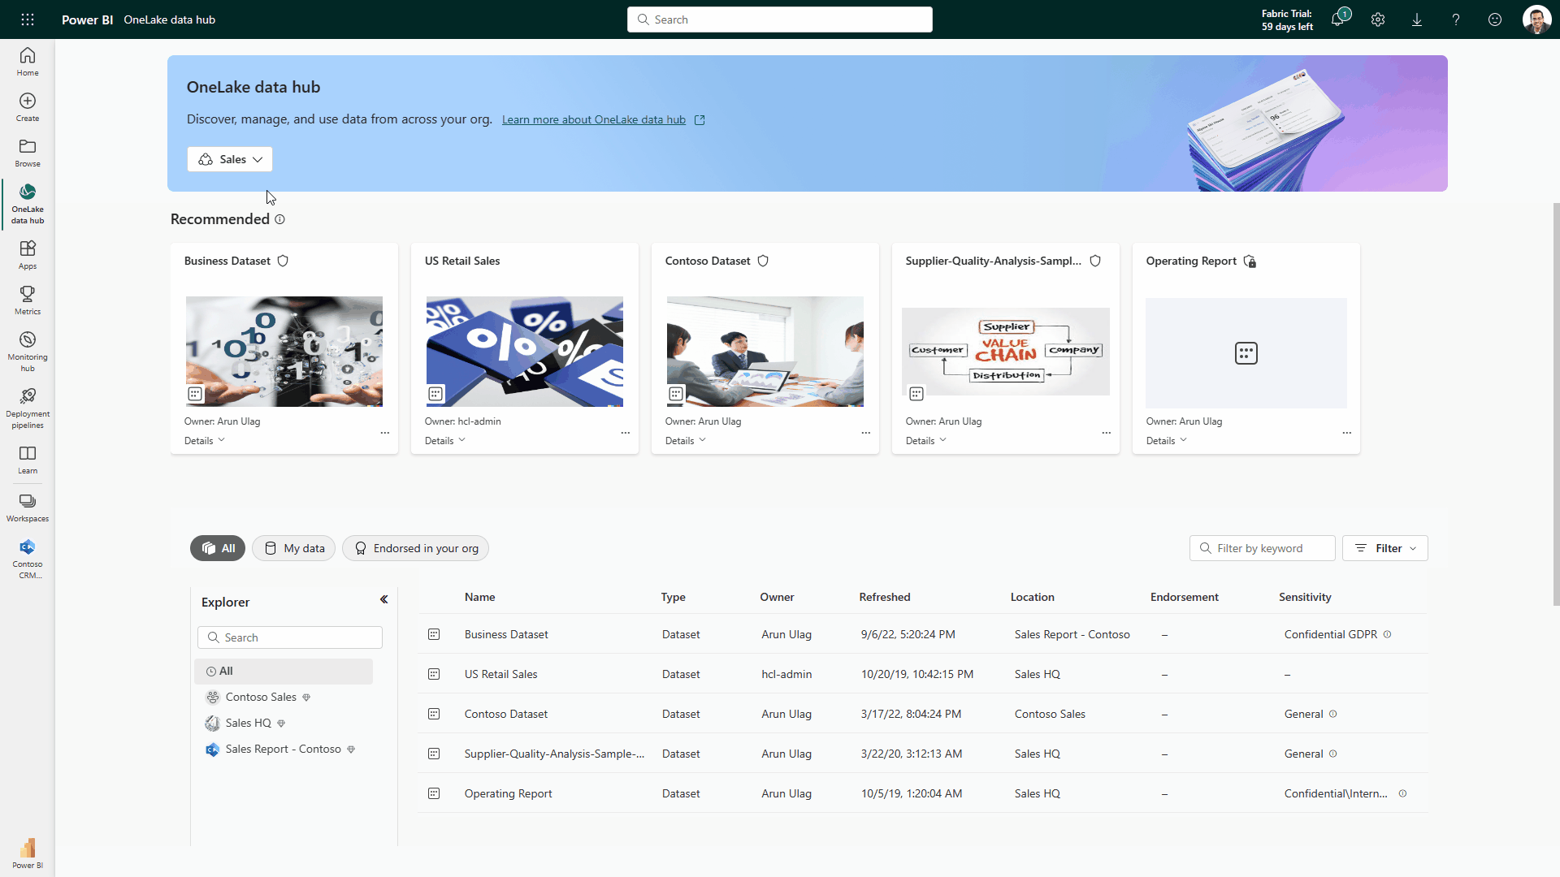
OneLake data hub
Discover, manage, and reuse data in one place
Central location within Fabric to discover, manage, and reuse data. Pervasive experience – available everywhere users discover data (create shortcuts, get data in dataflow, attach a notebook, create a dataset, and more).
Data can be easily discovered by its domain (e.g., Finance) so users can see what matters to them.
Efficient data discovery using search, filter and sort, or via browsing by folder (workspace) hierarchy.
Data actions such as preview, exploration, tracking lineage, report creation, analyze in Excel, and export can be easily done, even by non-technical users.
Available in Microsoft Teams, thus bringing OneLake Data hub to Office, enabling both technical and non-technical users with discovery, reuse and exploration.
Notes:
Colin to add notes

